Slide 1
Iterative Object Decomposition Inference Network (IODINE)
Presented by Meekail Zain

Slide 2
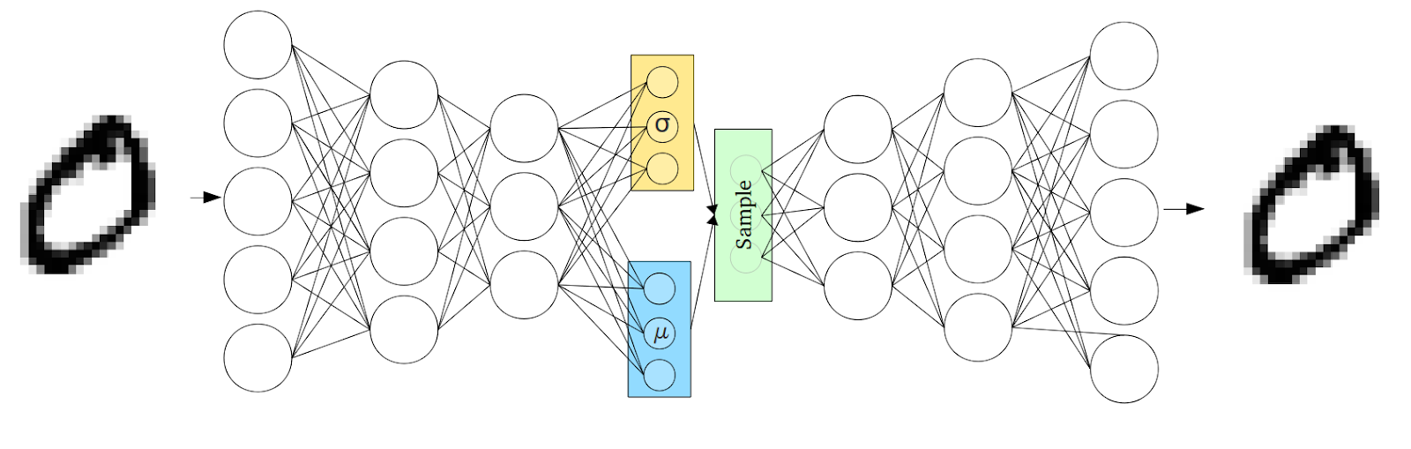
Background: Variational Auto-Encoders
Notes:
3 main components: Encoder, decoder and codes.

Slide 3
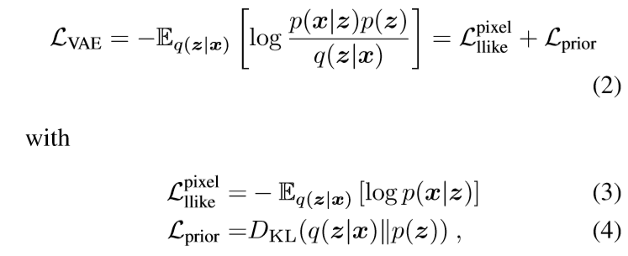
VAE Loss

Slide 4
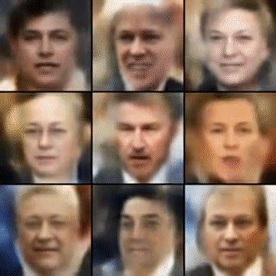
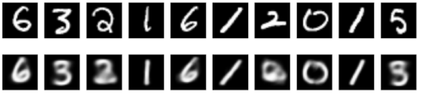
The Pros and Cons
Pros
(Relatively) simple architecture
Versatile
Leverages NO assumptions of data
Cons
“Blurry Images”
Restrictive prior
Restrictive posterior

Slide 5
Various Implementations
Encoders:
CNN
Feedforward
Any transformative network (e.g. discriminative networks)
Decoders:
Feedforward (reshaped)
Transpose convolution
Spatial Broadcast Decoding

Slide 6
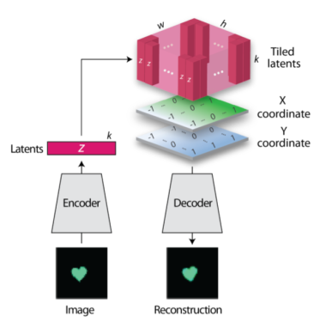
Spatial Broadcast
Decoding
Notes:
Appends Coordinate “guides” to encourage

Slide 7
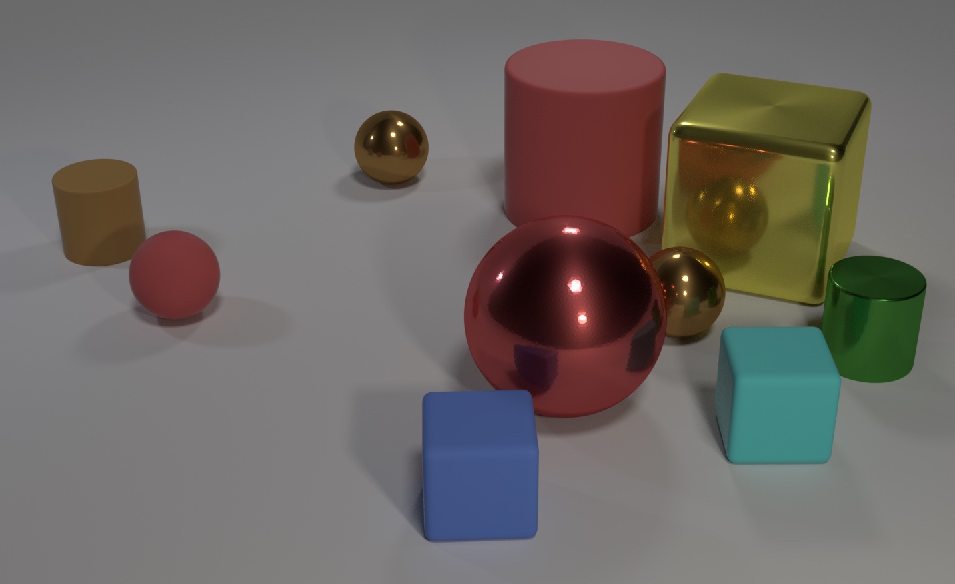
The Problem to Consider

Slide 8
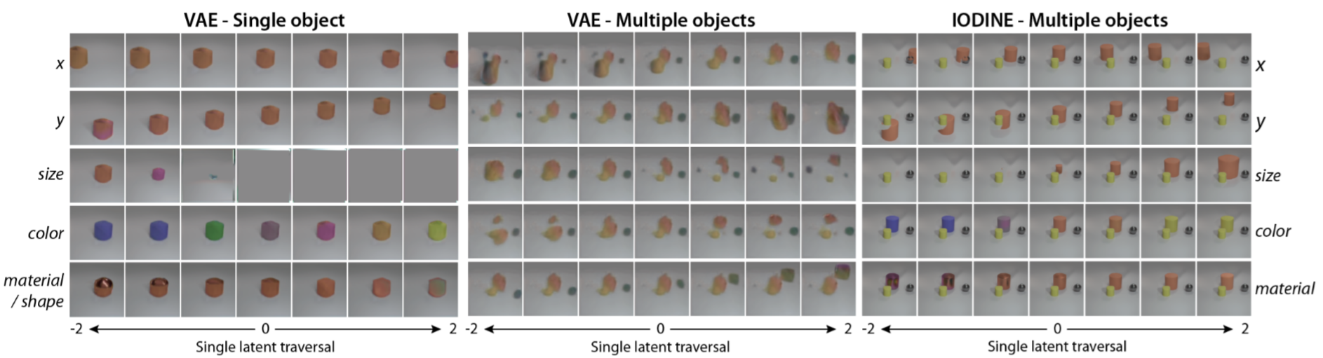
Why can’t we just keep it simple?

Slide 9
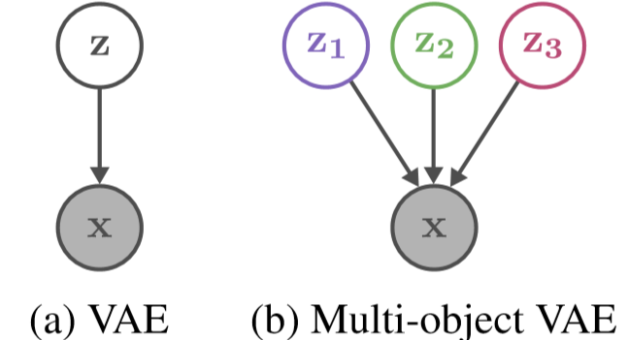
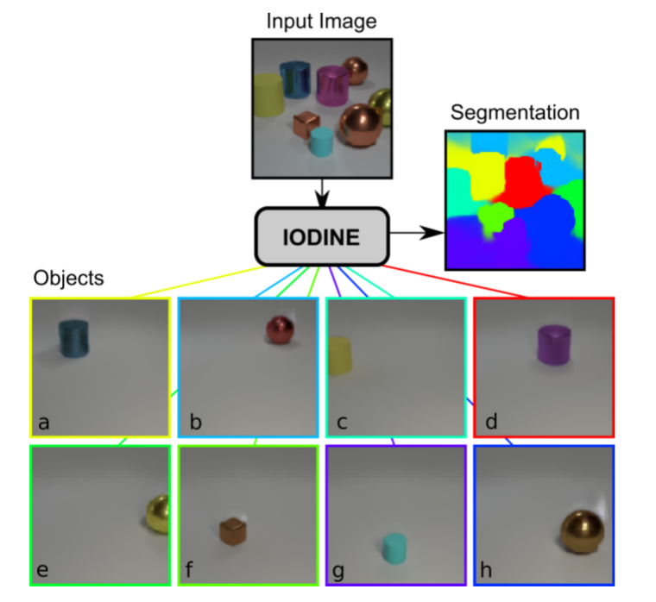
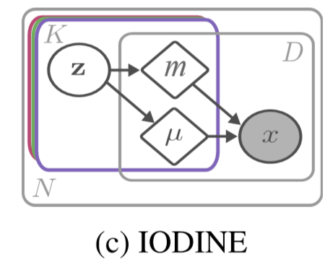
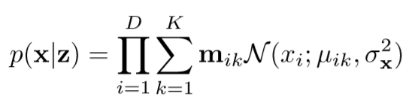
How does IODINE tackle the task?

Slide 10
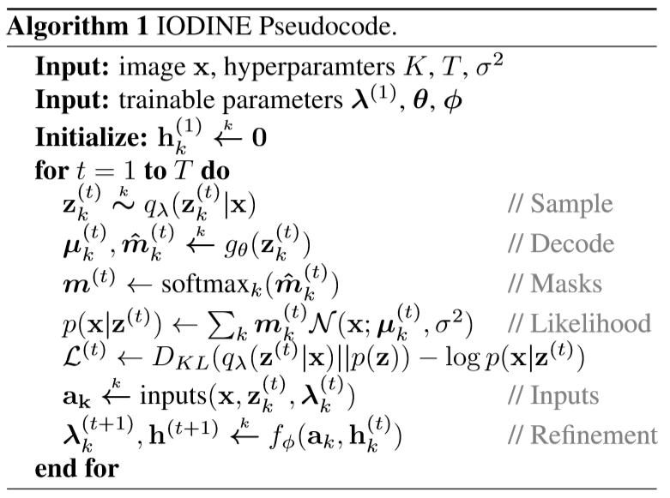
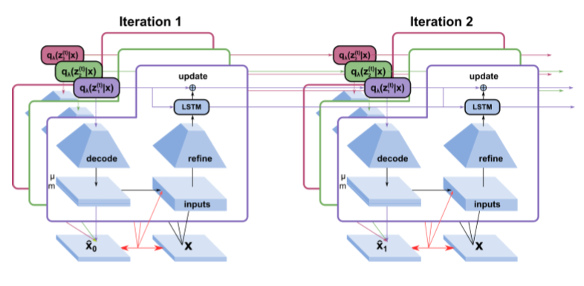
The Architecture

Slide 11
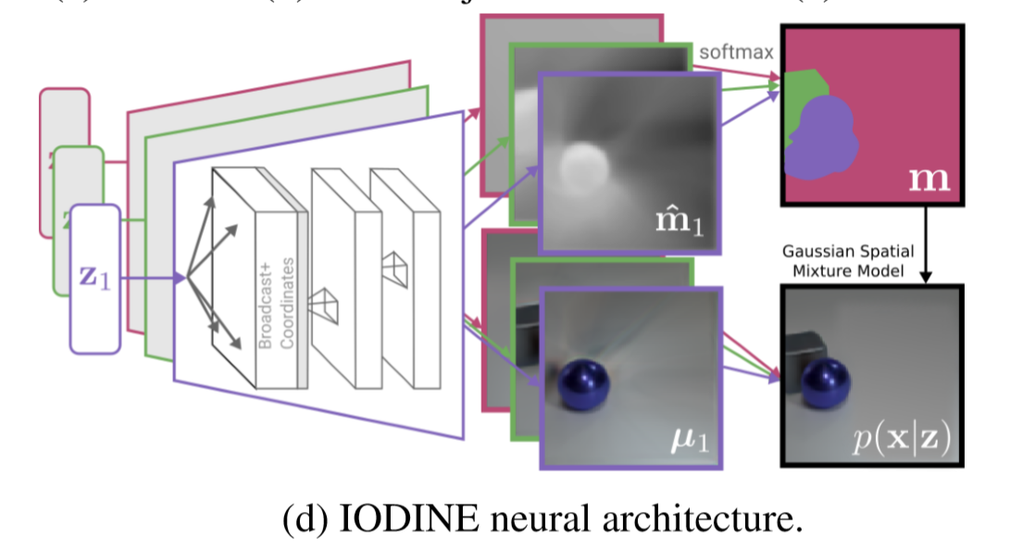
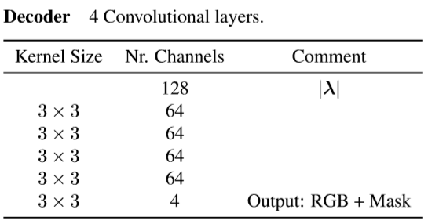
The Decoder

Slide 12
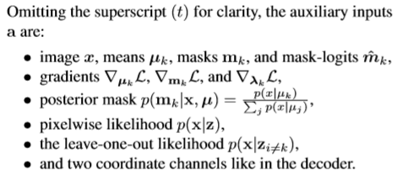
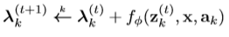
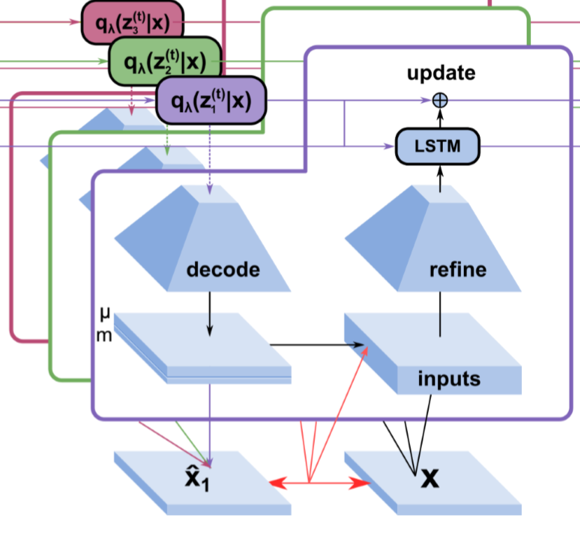
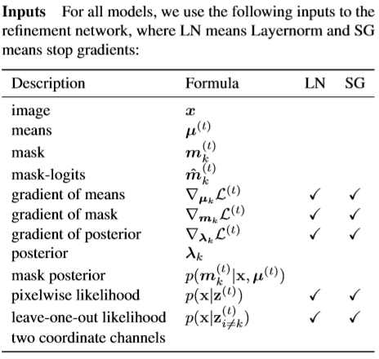
The Refinement Network

Slide 13
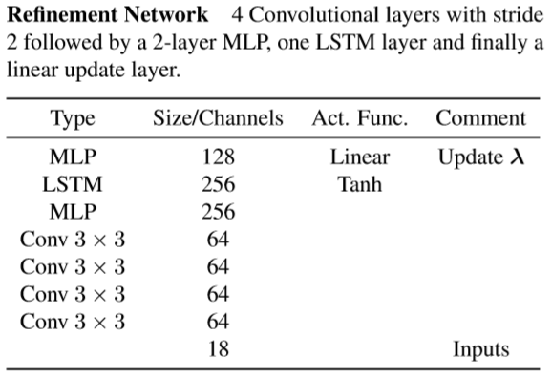
The Refinement Network Architecture

Slide 14
The Architecture 2: Electric Boogaloo

Slide 15
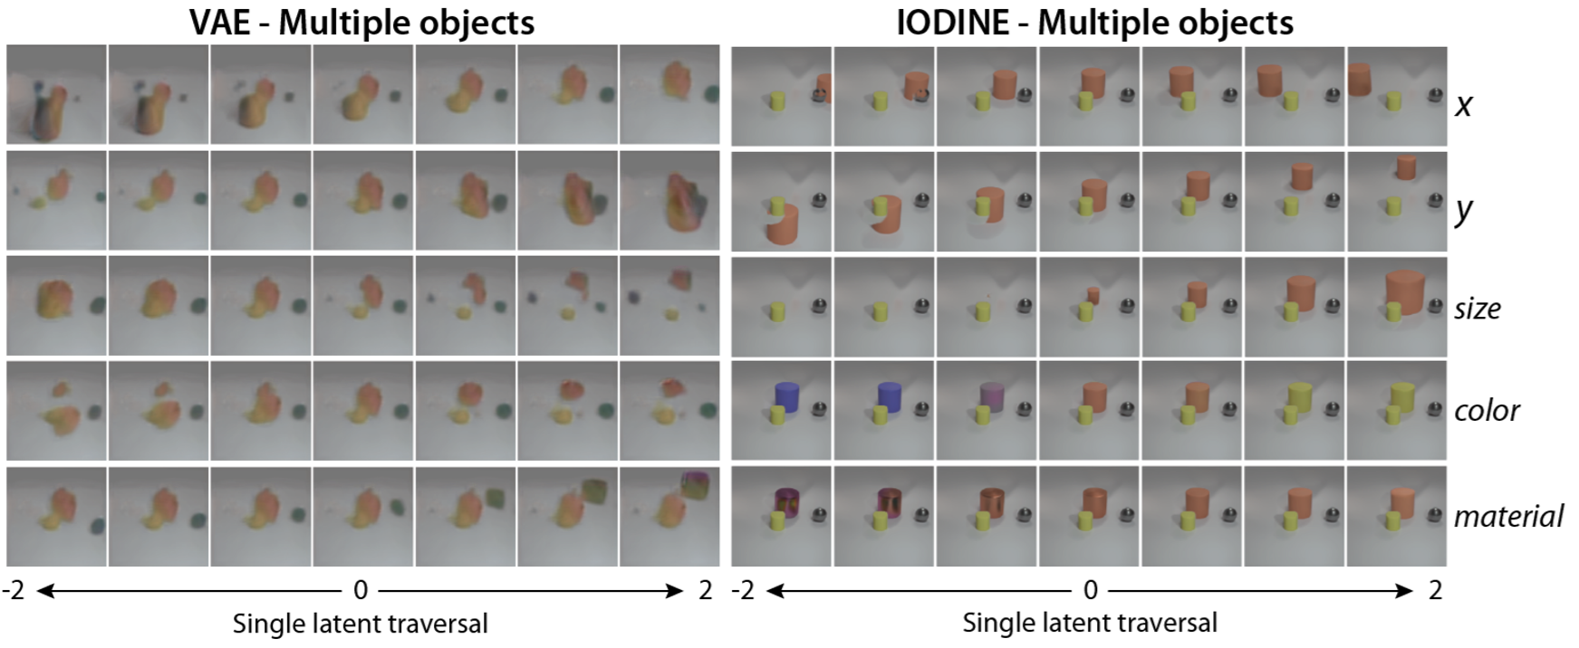
VAE vs IODINE

Slide 16
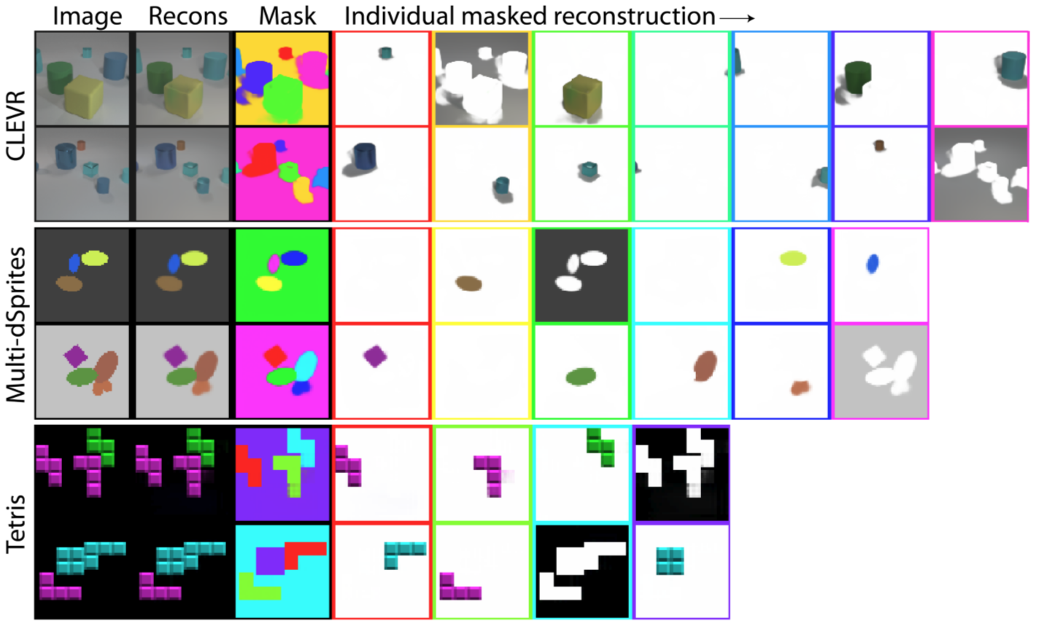
IODINE’s Inner Thoughts

Slide 17
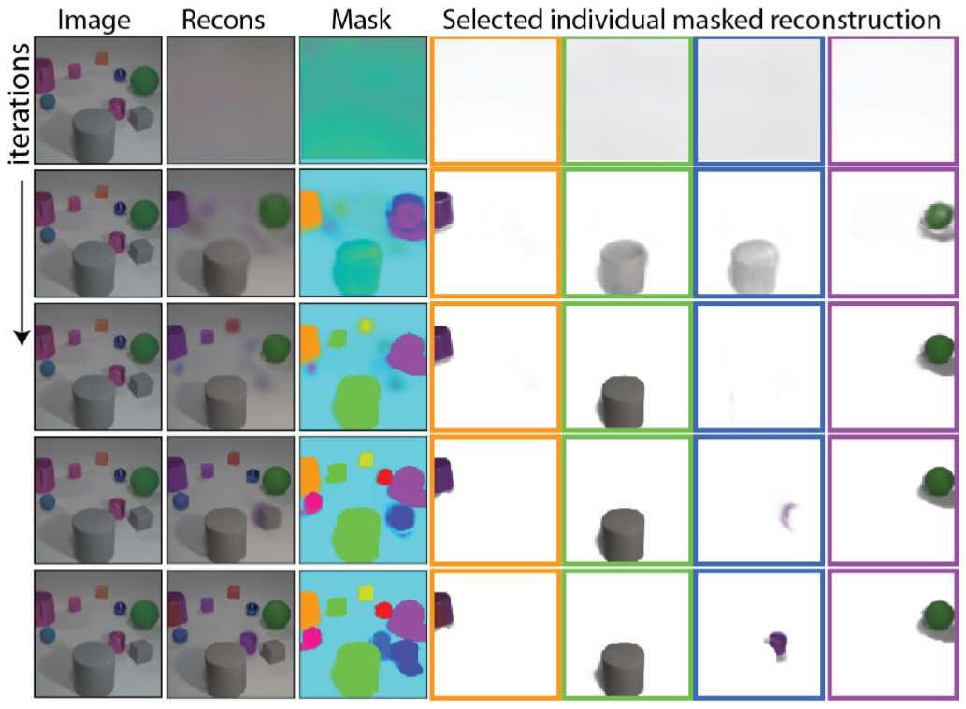
Iterative Modeling

Slide 18
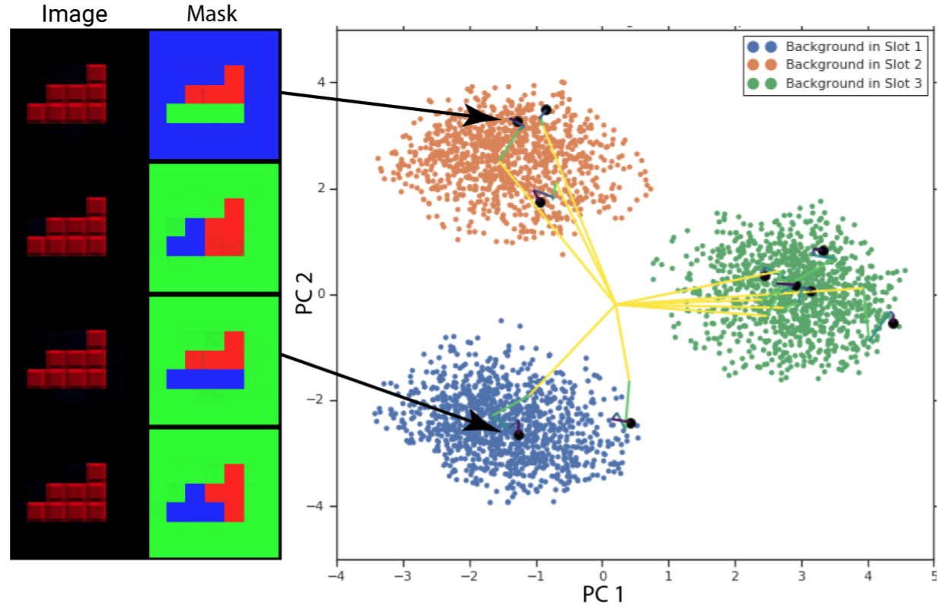
The Strength of a Random Start

Slide 19
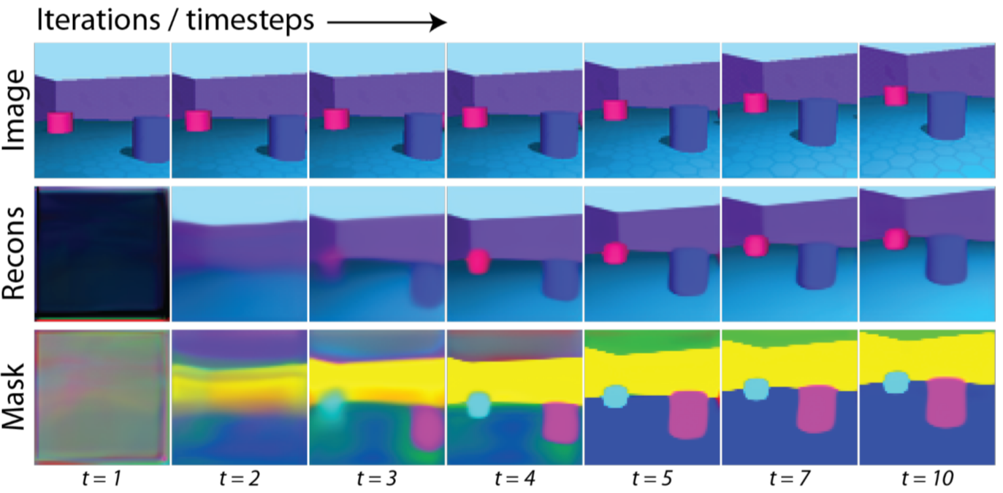
IODINE in Motion

Slide 20
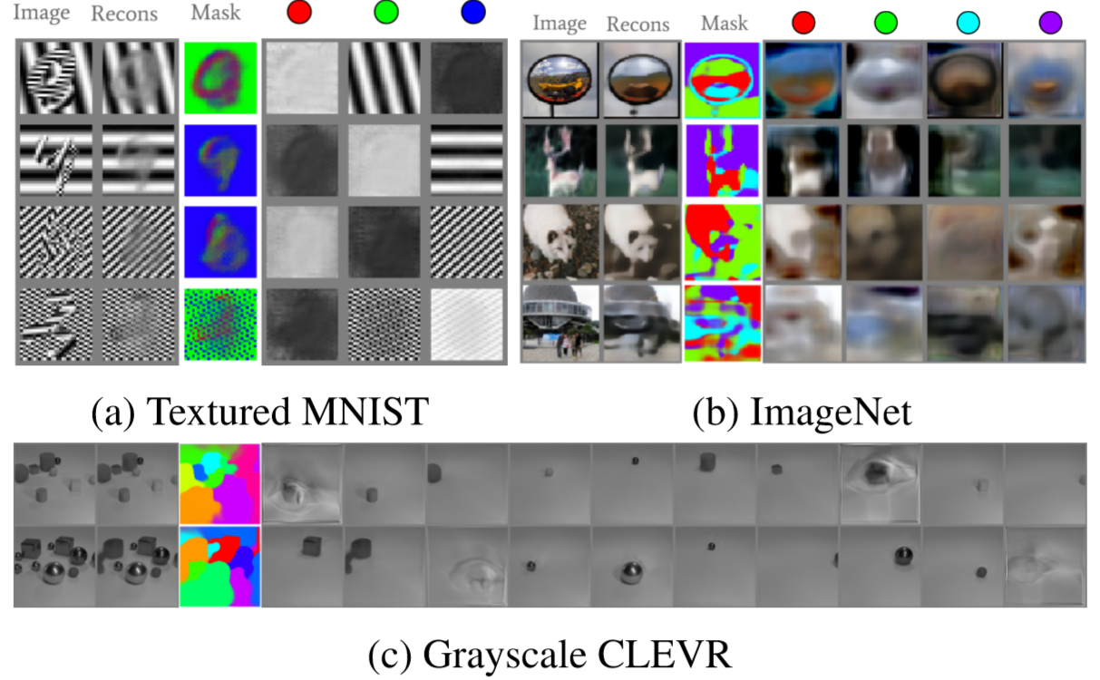
The Fault in our Stars Models

